Slide 1
ReStandard and Emergency First Aid and CPR C

Slide 2
ReSFA and Emergency CPR C Agenda
Review of online information
Skills testing
Modules
Quiz, Certification, Evaluations
Notes:
3.5-4 hour course including 1 x 15 minute breaks

Slide 3
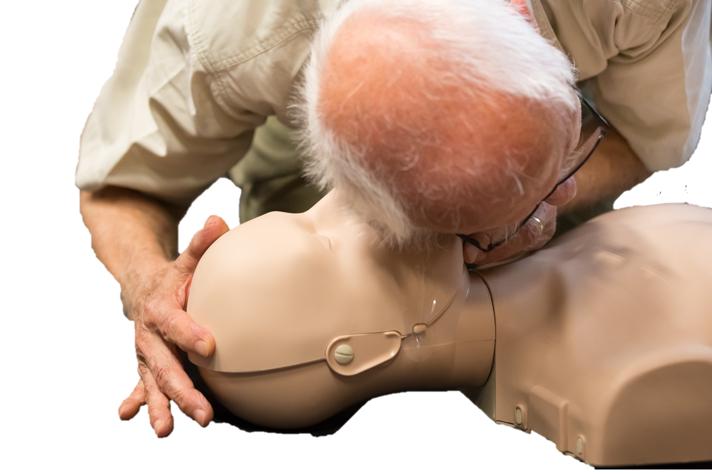
Review Priorities
Preserve life
Prevent further injury or illness
Promote recovery
Notes:
Total 15 minutes for Information and Terms
Give example.
Preserve life: CPR
Prevent further injury or illness: First aid treatments …for example splinting a possible fracture
Promote recovery: Identifying and getting stroke victim directed to stroke hospital

Slide 4
1. Have students gai Have students gain consent to perform first aid. .
Student Performance
Notes:
Student Skill – Students pair up and say to each other, “Hi my name is ______. I have first aid training. May I help you?”

Slide 5
Review Laws and Acts
Good Samaritan Act
Chase McEachern Act (Defibrillator act)
Ryan’s Law
Rowan’s Law
Sabrina’s Law
Notes:
Review all laws
Good Samaritan-Not liable for damages that result from the person’s negligence in acting or failing to act while providing the service
Practice within the scope of your training
VOLUNTEER: Not paid to provide service
SCOPE OF TRAINING: Stay within scope of training
Chase- AED in public places
Ryan-Puffers in schools
Rowan-Concussion protocols
Sabrina-EpiPen in schools

Slide 6
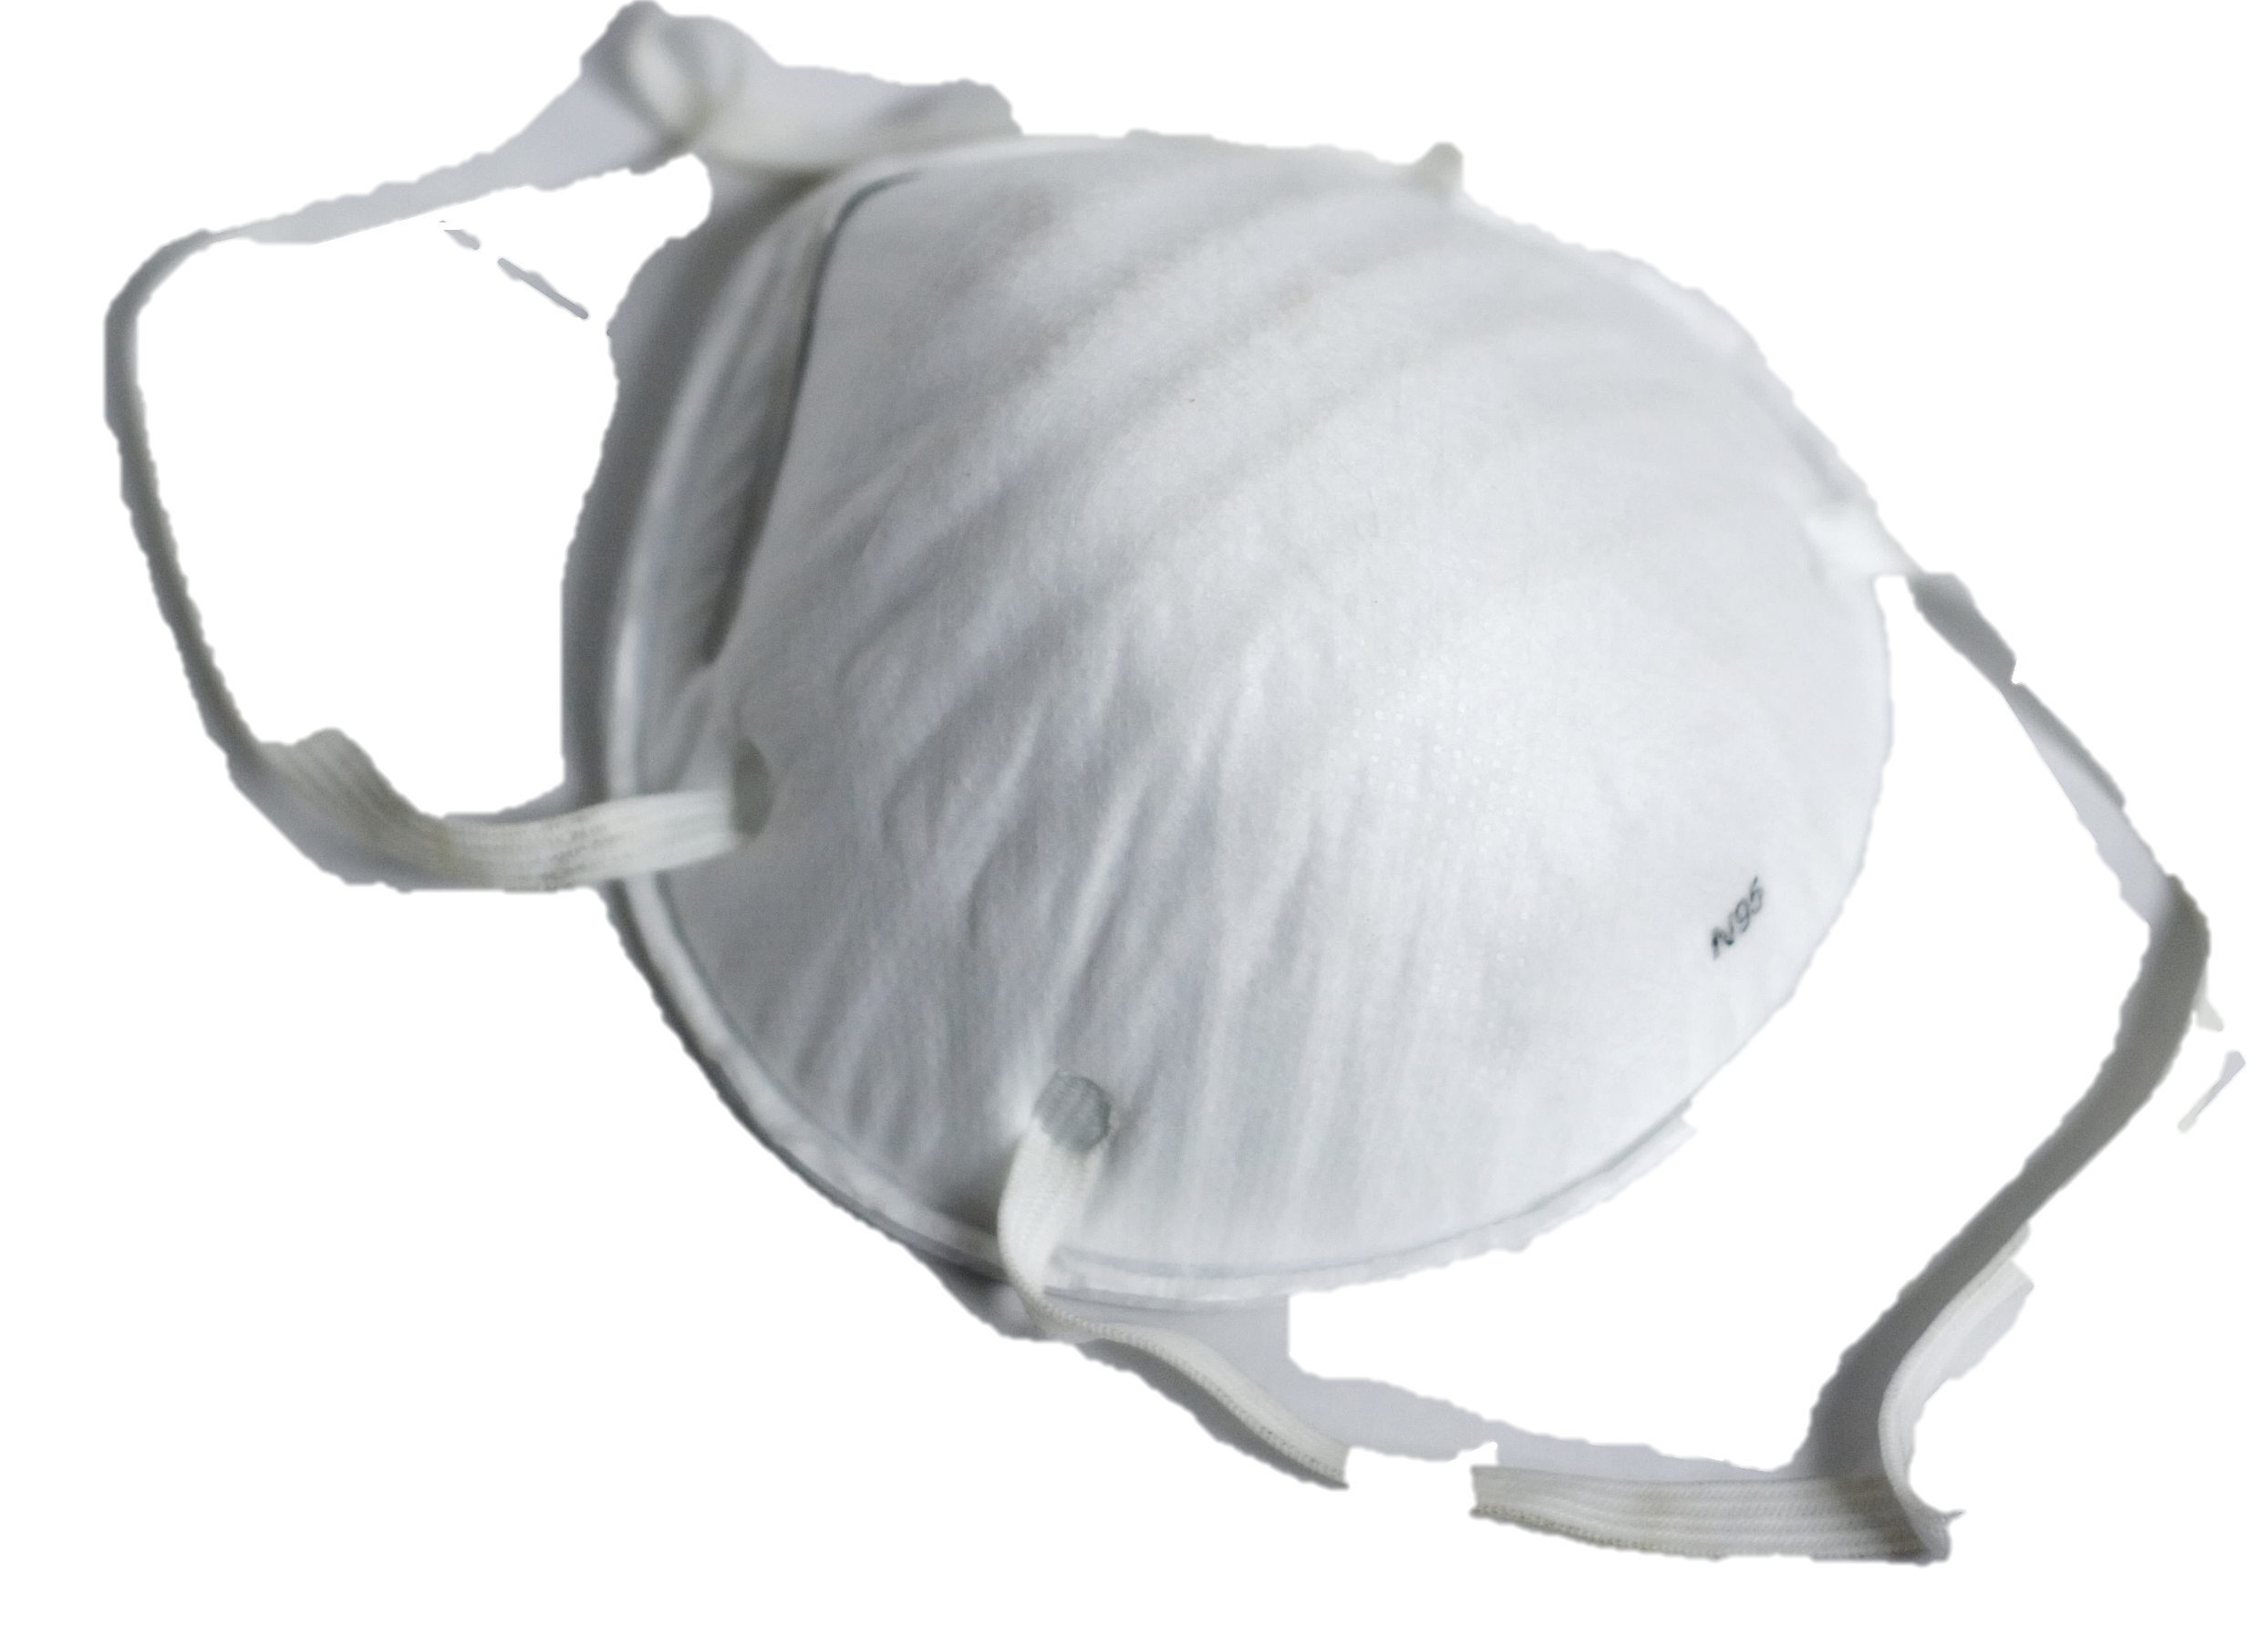
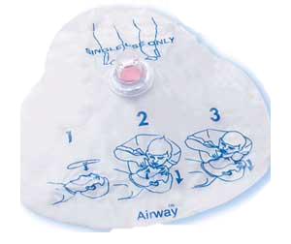
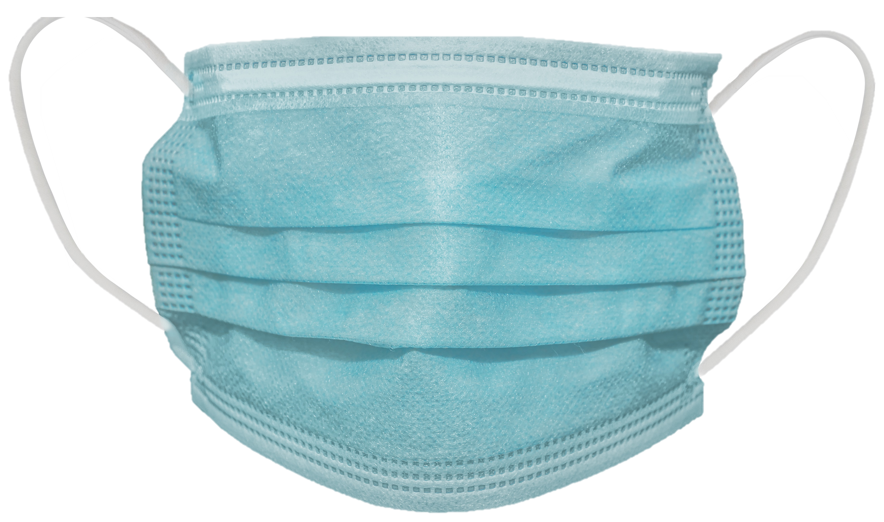
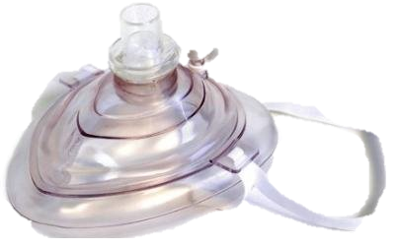
Review PPE
Discuss types, uses and disposal
Notes:
N95 Mask
Pocket mask with one way valve
Face shield with one way valve
Surgical mask 3 ply
Reusable cloth mask 2-3 layers

Slide 7
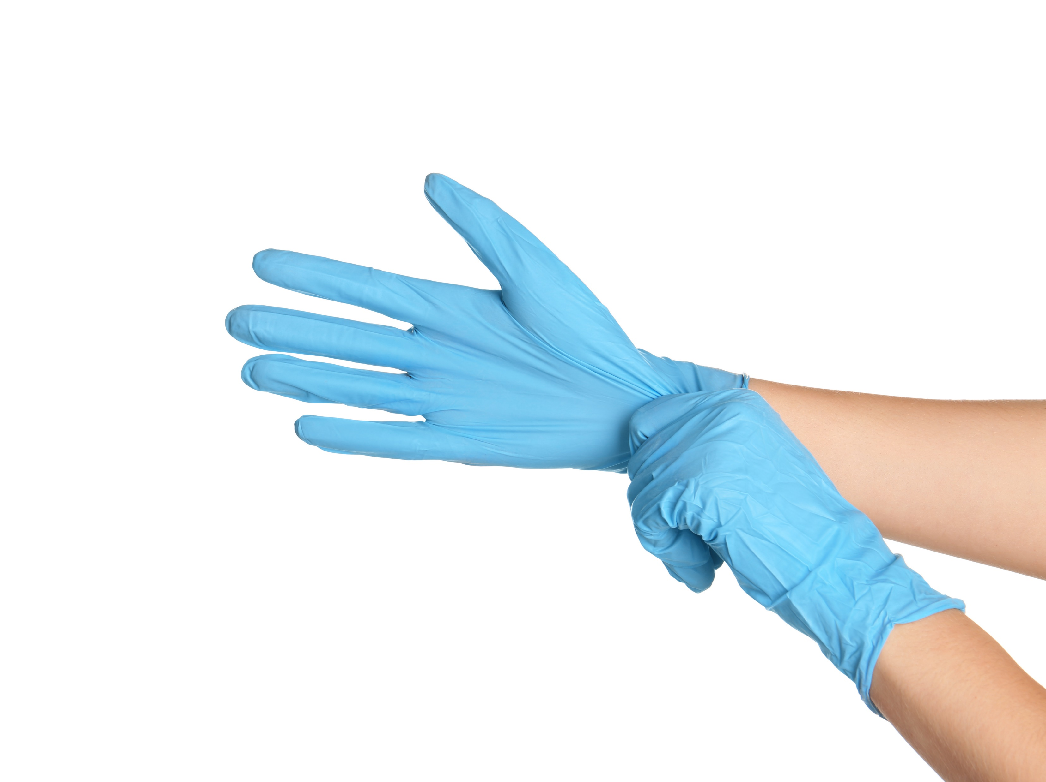
Student Performance
Have students perform glove removal and proper disposal
Notes:
REMOVAL OF GLOVES: FOLLOW 6 STEPS IN PHOTOS
Use one gloved hand to grab the palm of the second glove.
Slowly pull the second glove inside out into the palm of the first glove.
Slip a crooked finger of the first hand into the cuff of the gloved hand and slowly pull the glove down until both gloves are contained.
Dispose of in biohazard bag or double bagged garbage

Slide 8
Review Emergency Scene Management
Scene Survey
Primary Survey
Secondary Survey
Ongoing Care
Notes:
Total for ESM 30 minutes
Scene Survey
Look – Look around as you approach any emergency. You want to remove any hazards like fire, wires or glass. Find out how many people are injured and what happened.
Talk – Talk to the casualty, get consent, and check level of awareness.
Call – direct a bystander to call 911, and someone else to get a first aid kit and AED (start internal response) immediately when a casualty is seriously injured/ill or unresponsive.
Primary Survey
Airway – Open airway with head tilt, chin lift (HTCL).
Breathing – make sure casualty is breathing normally not agonal (gasping/fish out of water).
Circulation – check for signs of circulation such as coughing, breathing or movement, skin colour or active bleed.
Defibrillator – Deploy the AED immediately upon arrival (if needed)
Secondary Survey – when a casualty’s condition is minor and time will allow (ex. delayed EMS response).
Care and Monitoring – frequently monitor the casualty’s ABCs, treat for shock and reassure casualty. Record information and report to EMS on arrival.

Slide 9
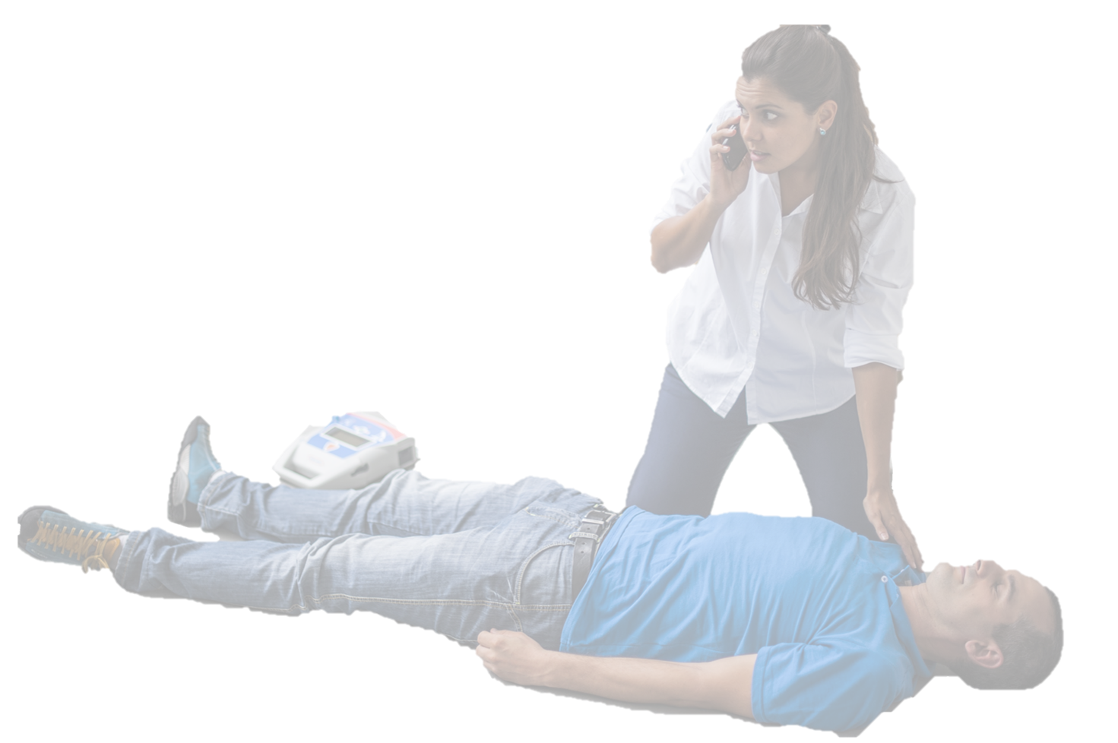
Review Scene and Primary Survey
Look, Talk, Call,
Airway, Breathing, Circulation
Notes:
Look, Talk, Call and AED,ABCD
Look for hazards, # of injured, MOI
Talk- Introduce, get consent, ask what happened. No verbal response? Tap and shout for 5 – 10 seconds
Call - Students should instruct bystander to call 911 and get AED or have another person get AED
AIRWAY –Place one hand on the casualty’s forehead and push down. With two fingers of the other hand, lift up under the casualty’s chin. Maintain this while casualty is unresponsive
BREATHING- Normal breathing described as at least one breath in and out every 5 – 10 seconds.
How to assess breathing- bring your cheek close to the casualty’s face looking towards the casualty’s chest.
DISCUSS AGONAL BREATHING – Appearance of breathing or gasping but no air movement. If unresponsive and not breathing, begin CPR with 30 compressions followed by 2 breaths, continue until AED arrives
If breathing normally, perform rapid body check looking for any severe bleeds, abnormalities, wet spots, medic alert
Look for DOTS- Deformities, Open Wounds, Tenderness or Swelling
Used gloved hands, gently squeeze the casualty’s body from head to toe.

Slide 10
Student Performance
Have demonstrate Look, Talk, Call, ABCD and then place a casualty into the recovery position and perform on going care.
Notes:
A shock position that is used for casualties that are breathing and have no suspected head or spinal injuries. Beneficial for casualty who is or may be vomiting.
Step 1
Kneel beside casualty’s waist area
Take casualty’s closest arm and move it gently above their head
Take
Step 2:
Use free hand to take the casualty’s opposite knee and pull on the knee to drag the casualty’s heel towards their buttocks. Hold knee in place
Now push the knee down towards the ground and guide the upper body over while holding the casualty’s arm. Do not pull on the arm.
Continue until the casualty’s knee is touching the ground in front of the first aider, with the casualty on their side.
casualty’s opposite arm and bring it across their chest, placing the hand on their shoulder. Hold in place for unresponsive casualty.
Step 3:
Ensure the casualty’s elbow is drawn up so the casualty’s face is tilted toward the ground.

Slide 11
Student Performance
Have students perform Scene survey, primary survey and ongoing care with a suspected spinal injury.
Notes:
GROUPS OF 3 OR MORE
1. LOOK, TALK – “DO NOT MOVE” approach from side or feet
2. Instruct a first aider to support head IN POSITION FOUND
Kneels at head, support arms on the ground, Place both hands on either side of the head not pressing o the ears. Instruct another person to call 911 and get an AED
4. Perform a quick rapid body check
5. Perform first aid and cover, rest and monitor ABCs until EMS arrives

Slide 12
Student Performance
Demonstrate a casualty roll to the group.
Notes:
Chooses which side to roll casualty so face doesn’t roll across ground
Place yourself on the side you are rolling the casualty toward and place the arm closest to you above their head gently
Place the opposite leg over and across the leg closest to you
Place hand onto casualty’s shoulder and grabs it
Place other hand on casualty’s waist and arm
Smoothly roll casualty toward first aider onto their side. Stop and reposition hand from shoulder to head
Roll casualty the rest of the way down to ground
Cover, reassure, monitor ABC’s until EMS arrives

Slide 13
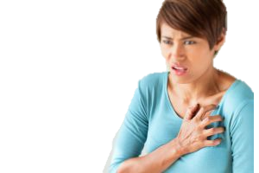
Review Cardiovascular Emergency
Signs, Symptoms and first aid treatment for:
Heart Attack: P.A.S.S. I.T. O.N.
Stroke: F.A.S.T.
ASA
Nitro
Notes:
STATS Canada 2008- Cardiovascular Deaths
54% Ischemic Heart Disease, 20% Stroke. 23% Heart Attack
DISCUSS RISK FACTORS FOR CARDIOVASCULAR DISEASE: Obesity, smoking, heredity, stress, genetics, stress
DISCUSS PREVENTION: Exercise, not smoking, good diet, stress free life

Slide 14
Review CPR
 | Adult | Child | Infant
Ages | Over 8 | 1 -8 years | Under 1 year
Call 911 | Unresponsive | Unresponsive | Unresponsive
Lone Rescuer | Immediately | After 2 mins. | After 2 mins.
Ratio | 30:2 | 30:2 | 30:2
Depth | At least 2” (5-6 cm) | 1/3 diameter or 2” (5 cm) | 1/3 diameter or 1.5”(4 cm)
Technique | 2 hands | 1 or 2 hands | Two fingers
Use AED | Yes | Yes | Yes
Notes:
Total for 35 minutes Adult and Child CPR AED and Choking

Slide 15
Student Performance
Have students perform look, talk, call, ABCDs. Casualty is not breathing.
Student to perform CPR 30:2 one rescuer for minimum 5 cycles.
Pairs to perform two rescuer CPR for minimum 5 cycles
Notes:
SCENARIO 1. Each student must perform this skill
1. LOOK, TALK, CALL, ABCD – Delegate someone to call 911 and someone to get AED. Indicate that casualty is not breathing.
2. Immediately start chest compressions (30:2) pushing down at least 2”. Push hard, push fast.
3. Put barrier device in place, then perform head-tilt-chin-lift.
4. Give 2 rescue breaths lasting 1 second each Watch for chest rise. Reposition if first breath does not go in and attempt 2nd breath.
5. Continue CPR
SCENARIO 2-Each student to perform a minimum of 5 cycles or 2 minutes of CPR. Teamwork, communication to help each other with encouraging words and coaching.
BREATHS- Person providing breaths will be positioned by casualty's head, ideally on opposite side from first aider doing compressions. Maintain head tilt chin lift and the barrier device on casualty’s face during compressions.
COMPRESSIONS- Ensure that you count out loud, so the other first aider can be prepared to give breaths immediately after the 30th compression for minimal interruption of CPR. Do not remove your hand from the casualty's chest during rescue breaths instead let them rest lightly on the chest. Let the other first aider know whether the breath was successful
SWITCHING POSITIONS – WHEN THE 5TH CYCLE OF CPR IS IN PROGRESS, COMMUNICATE THAT AFTER THE 30TH COMPRESSION, THE SWITCHING OF POSITIONS SHOULD OCCURE. EACH FIRST AIDER WILL STAY ON THE SIDE THEY ARE ON, BUT SWITCH ROLES.
SWITCHING POSITIONS – WHEN THE 5TH CYCLE OF CPR IS IN PROGRESS, COMMUNICATE THAT AFTER THE 30TH COMPRESSION, THE SWITCHING OF POSITIONS SHOULD OCCURE. EACH FIRST AIDER WILL STAY ON THE SIDE THEY ARE ON, BUT SWITCH ROLES.

Slide 16
Student Performance
Student is to perform look, talk, call, ABCDs. Perform CPR until the AED arrives.
Continue to follow AED instructions for 2 analyzes, ensuring at least 2 position switches between rescuers performing CPR.
Notes:
Student performs LOOK, TALK, CALL, ABCD’S and performs CPR until AED arrives.
When AED arrives, another first aider takes over CPR, while the student performing the skill moves on to use the AED.
Place AED at head of casualty beside first aider.
Turn it on. Remove clothes and ensure chest is dry.
Do not touch casualty while analyzing. Administer shock ensuring all is clear.
Continue CPR for 2 minutes until next analyze.
No Shock Advised – Continue CPR until EMS arrives

Slide 17
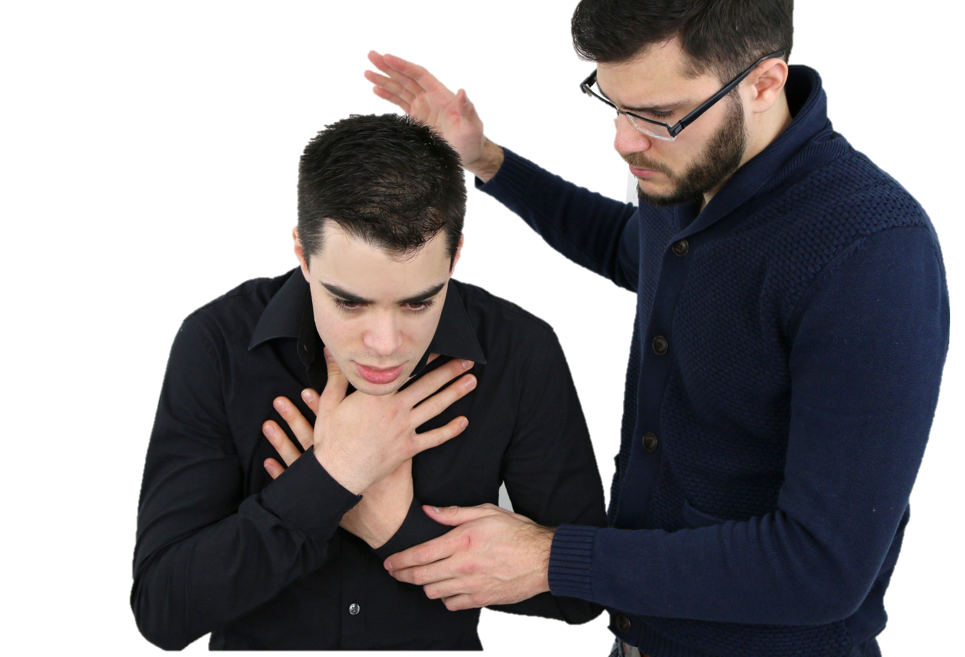
Review
Mild Choking
Can still cough, talk , breath, flushed (red) skin
Tell them to continue they are doing the right thing and stay with them
Severe Choking
Unable to cough, talk or breath. May be grasping neck, panicked look on face and may become pale

Slide 18
Student Performance
Student to perform treatment to a simulated mild choking casualty.
Student to simulate first aid treatment on a severe choking. Perform 2 sets of back blows and abdominal thrusts.
Notes:
Instructor Demonstrates and then have students pair up.
Student #1 – Casualty mildly choking, coughing effectively Student #2- Performs
LOOK, TALK, CALL, ABCDS
Encourage casualty to keep coughing and reassures them. Stays with them. Ideally, keep a hand on casualty’s shoulder for reassurance.
Switch roles.
SIMULATED CASUALTY SEVERE CHOKING: Student performs: (2 SETS)
LOOK, TALK, CALL, ABCD. and proceeds with 5 simulated back blows and 5 simulated abdominal thrusts. 2 sets
HAVE STUDENTS SWITCH ROLES

Slide 19
Student Performance
Manikin becomes the unresponsive choking casualty. Student is to perform first aid treatment for a responsive to unresponsive choking casualty.
Notes:
SEVERE TO UNCONSCIOUS CHOKING CASUALTY (USE MANIKIN) Have just assisted severe to unconscious casualty to the floor.
Ensure 911 has been called. Call for AED
30 compressions then look in mouth for object. If found, remove it.
If not found, attempt 2 rescue breaths. Continue with 30 compressions etc until casualty recovers, AED arrives or EMS takes over. Ensure 2 minutes of CPR

Slide 20
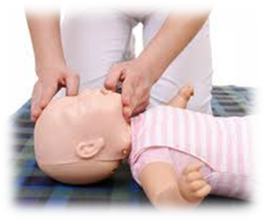
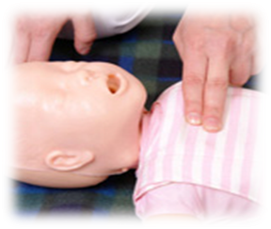
Review Infant CPR
Two fingers just below the nipple line in the centre of the chest
Head tilt chin lift into
sniffing position cover infant nose and mouth
Pushing down 1^{1/2} inches (4cm) or 1/3 of chest depth
Notes:
Total 20 minutes for Infant CPR

Slide 21
Student Performance
Have students perform look, talk, call, ABCDs. Infant casualty is not breathing. Student to perform CPR 30:2 for minimum 5 cycles.
Notes:
STUDENT PERFORMANCE:
Use manikin. Perform 30 chest thrusts. Check mouth. Attempt 1 breath. Does not go in. Reposition & attempt 2nd breath. Does not go in
30 compressions. Check mouth. Find food. Remove it.
Give 2 breaths and begin compressions. After 10 compressions….infant to show signs of life. Place on side. Monitor ABC’s while keeping an eye on parents and keeping them informed. Until EMS arrives.

Slide 22
Student Performance
Have students perform 30 compressions and check mouth. Nothing found attempt a breath, readjust and attempt a 2nd breath. Continue for minimum 5 cycles.
Notes:
STUDENT PERFORMANCE:
Use manikin. Perform 30 chest thrusts. Check mouth. Attempt 1 breath. Does not go in. Reposition & attempt 2nd breath. Does not go in
30 compressions. Check mouth. Find food. Remove it.
Give 2 breaths and begin compressions. After 10 compressions….infant to show signs of life. Place on side. Monitor ABC’s while keeping an eye on parents and keeping them informed. Until EMS arrives.

Slide 23
Review Wounds and Bleeds
Review the signs, symptoms and first aid treatment:
Internal vs External Bleeds
Minor wound care
Nosebleed
Bee Stings
Notes:
Total 25 mins for Wounds and Bleeds

Slide 24
Student Performance
Student to perform bandaging on a laceration to the forearm.
Student to perform a distal circulation check.
Student to perform first aid treatment for a short embedded object.
Student to perform bandaging of a palm wound.

Slide 25
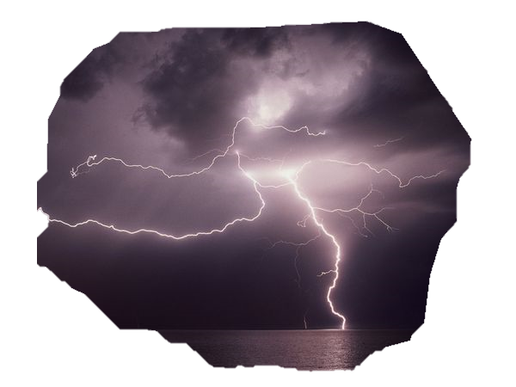
Review Burns
Review the signs, symptoms and first aid treatment:
First, second and third degree burns from heat
First, second and third degree burns from chemical
First, second and third degree burns from electrical
Notes:
Total 5 minutes for burns
1ST AND 2ND DEGREE SMALL BURNS (<20%) Cool with water for 15-20 min intervals until not painful. Apply moisturizer only after burn is cool. Do not break blisters. Watch for infection. If blisters break, cover loosely and watch for infection and have casualty rehydrate. If infection occurs, seek medical help.
LARGE 2ND DEGREE AND 3RD DEGREE BURNS:
Do not flush. Apply sterile gauze lightly over area, reassure, cover monitor ABC’s often
CHEMICAL: Dry: Brush off excess chemicals. Remove contaminated clothing and jewelry and rinse with water for 20 minutes. Loosely cover with gauze.
Liquid: Remove contaminated clothing and any jewellry. Rinse with water for 20 minutes. Loosely cover with gauze.
All chemical burns must be seen at hospital. Take MSDS

Slide 26
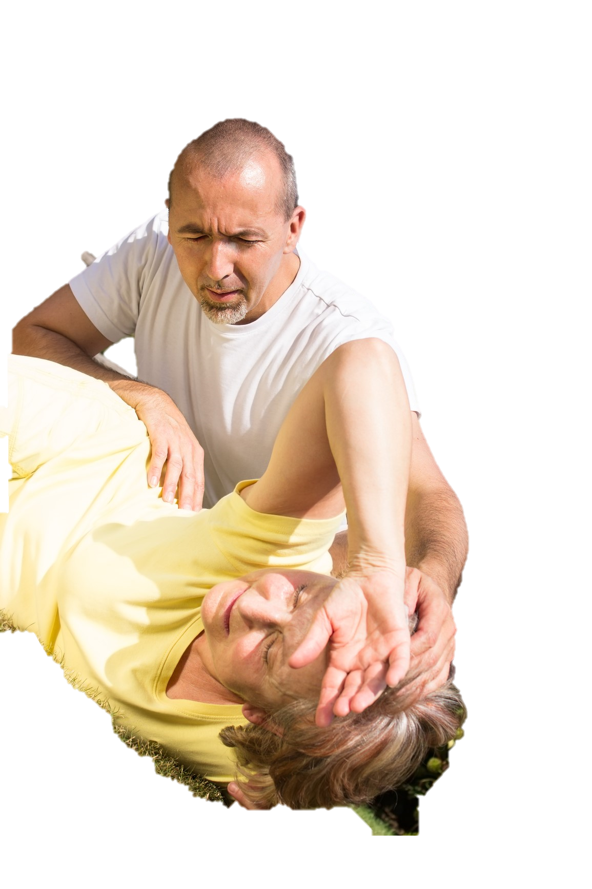
Review Medical Emergencies
Review the signs, symptoms and first aid treatment:
Diabetic Emergency
Seizures
Asthma
Severe Allergic Reaction
Notes:
Total 15 minutes for Medical Emergencies

Slide 27
Certifications Course Evaluations
Thank you for caring enough to train
Notes:
15 minutes for Course Evaluations and certificates

